Slide 1
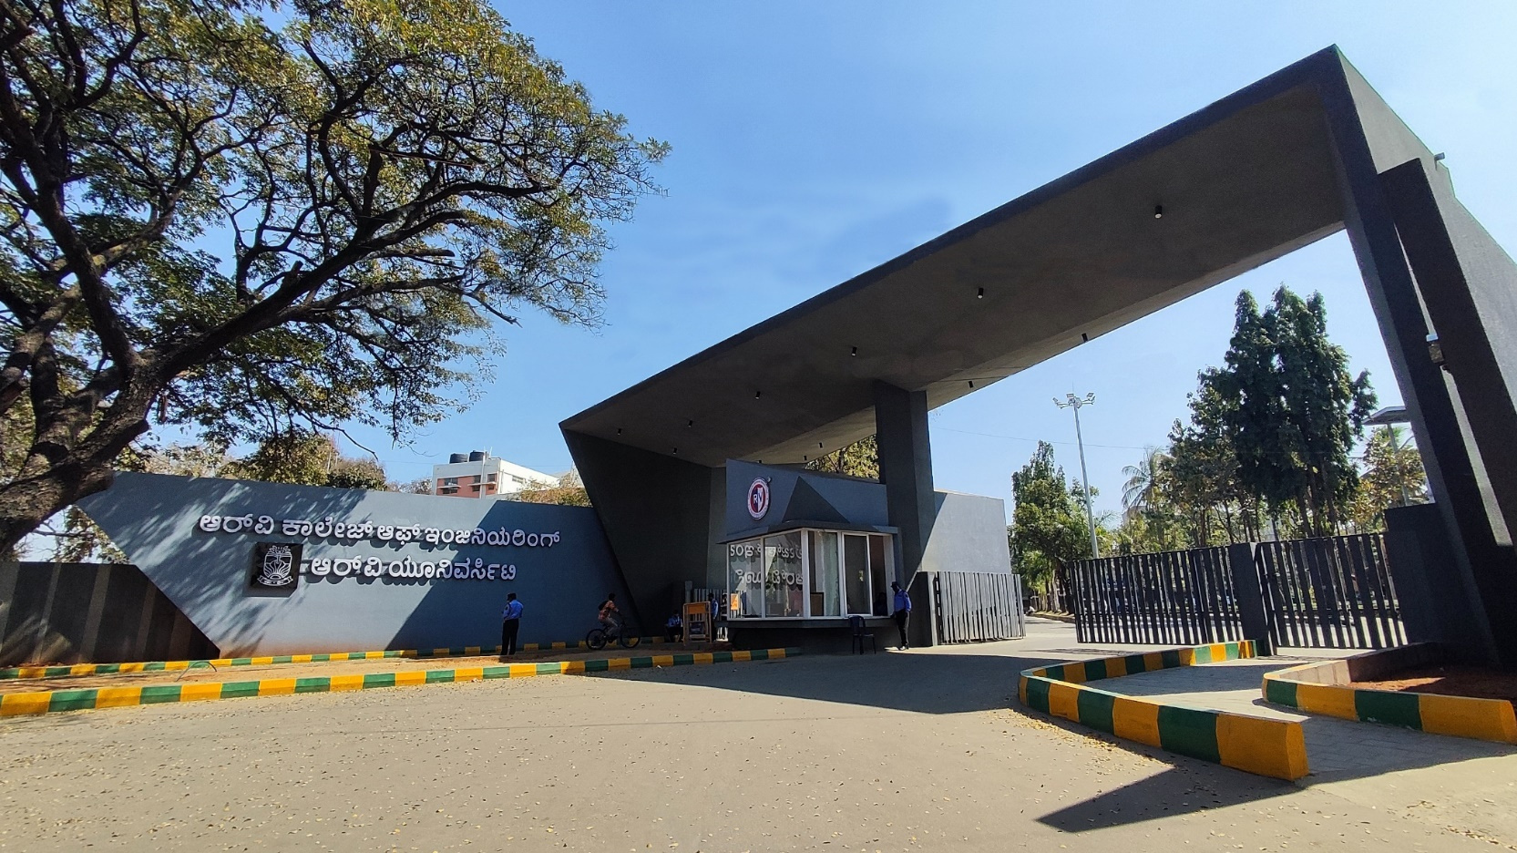

Application of AI in Garment Industry
Go, change the world

Slide 2




Textile-Damage Detection
Imagine a robot with super-eyes, that's AI looking at clothes! AI helps find boo-boos in fabric super fast. Let's see how AI keeps our clothes perfect!
How Does AI "See" Fabric Flaws?
AI Learns "Good" Fabric
Training with Pictures
Spotting Mistakes
AI studies what perfect fabric looks like, like learning the alphabet!
It sees many pictures of good and bad fabric to understand differences.
Then, AI spots mistakes like a puzzle master finding missing pieces!
AI can find holes, stains, or uneven colors in fabric. It learns what is normal, then flags anything that is not.

Slide 3
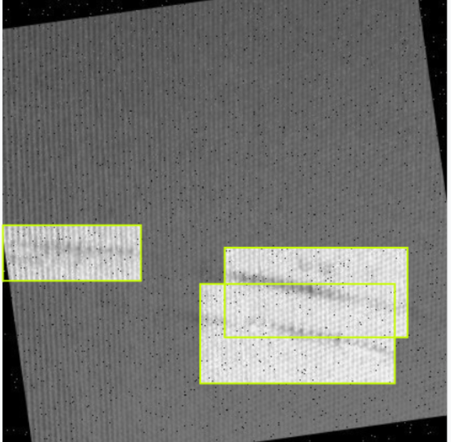
Textile-Damage Detection
AI to the Rescue: Finding Textile Troubles
1
AI Cameras Watch
Factories use AI cameras to check fabric as it's made.
2
Pictures are Taken
The AI camera takes a picture of the fabric.
3
AI Checks Every Inch
The AI quickly looks for issues and doesn't get tired!
It's like having a superhero inspector watching every thread, making sure nothing is missed. This helps production stay efficient.

Slide 4
Textile-Damage Detection
Dataset Information
Model Details
Parameters
- Source: Roboflow (textile-defect-ig0ek dataset)
- Split:
- Training: `train/images/`
- Validation: `valid/images/`
- Testing: `test/images/`
- Class: Single class ('0' - defect)
- Format: YOLO format annotations
- Visualization of predictions
- Performance metrics and graphs
Would you like me to provide more specific details about any of these aspects?
1. Training Parameters:
- Batch size: 8
- Epochs: 100
- Image size: 640x640
- Learning rate: Auto (AdamW optimizer)
- Augmentation:
- Mosaic: 0.5 probability
- Mixup: Disabled
- Copy-paste: Disabled
2. Model Parameters:
- Confidence threshold: 0.25
- IoU threshold: 0.7
- Max detections: 300
5. Model saving and evaluation
### Output
- Trained model saved as 'textile_defect_model.pt'
- Training logs and metrics in 'runs/train/'
- Base Model: YOLOv8-nano
- Architecture:
- Input size: 640x640 pixels
- Number of classes: 1 (defect detection)
- Backbone: CSPDarknet
- Neck: PANet
- Head: Detection head

Slide 5
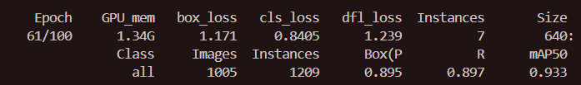
Textile-Damage Detection
What We’re Predicting
Performance Metrics
Output
Task: Object Detection
- Output:
- Bounding boxes around defects
- Confidence scores
- Class predictions
- Metrics:
- mAP50 (mean Average Precision at IoU 0.5)
- Precision
- Recall
- F1-score
- Real-time processing capability
- High detection accuracy
- Low false positive rate
- Fast inference speed
1. Data preprocessing
2. Model initialization with pretrained weights
3. Training with early stopping (patience: 50)
4. Validation on separate dataset
5. Model saving and evaluation
- Trained model saved as 'textile_defect_model.pt'
- Training logs and metrics in 'runs/train/'
- Visualization of predictions
- Performance metrics and graphs
Training Process

Slide 6
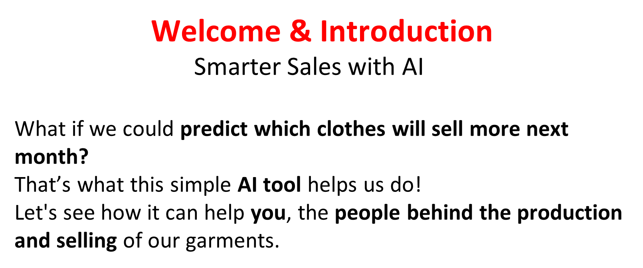
Inventory Management

Slide 7
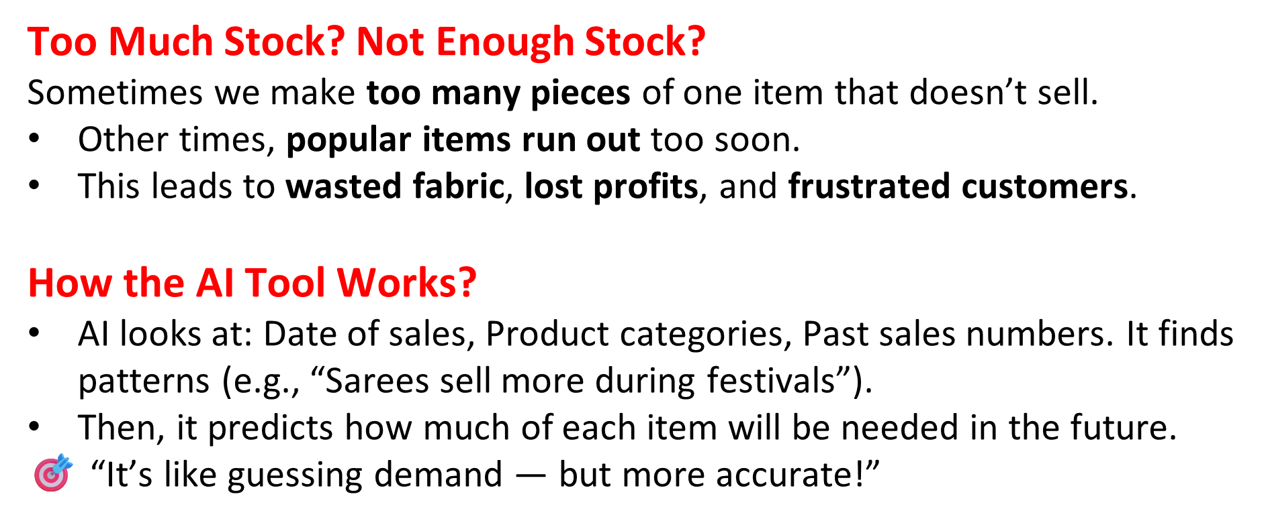
Inventory Management

Slide 8
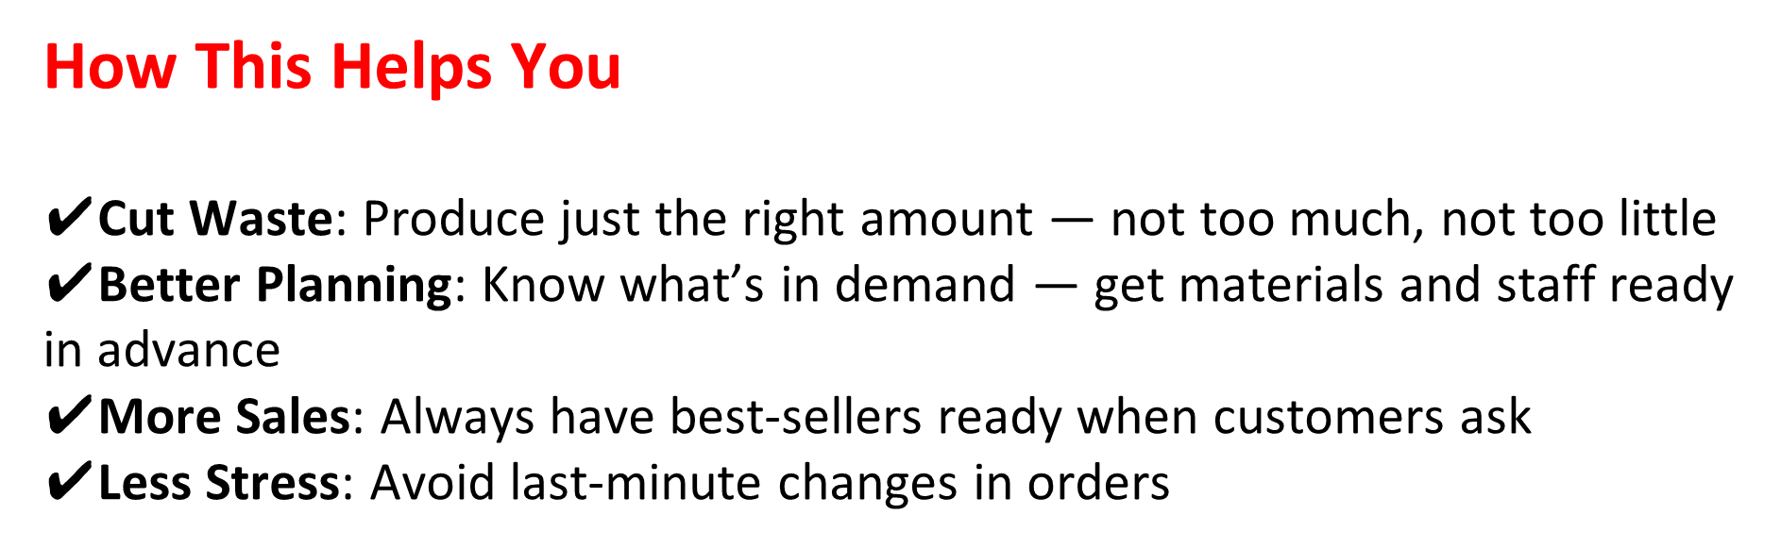
Inventory Management

Slide 9
Inventory Management
Dataset Overview
Columns in Dataset:
DATE → Date of sale
VALUE → Unit price (₹ per kg)
PFco_Code → Fabric/Product code (categorical)
Total_values → Total transaction value (₹)
QUANTITIES_Kgs → Quantity sold (Target Variable)

Slide 10
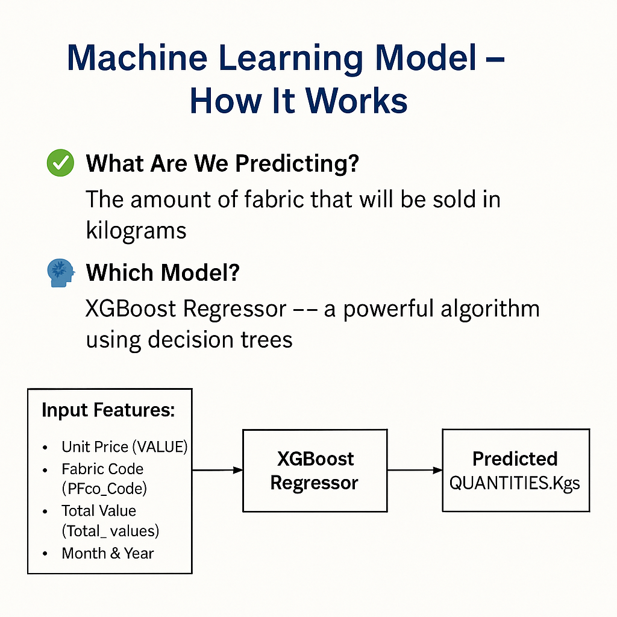
Inventory Management
How the ML Model works?
What Are We Predicting? The amount of fabric that will be sold in kilograms.
Which Model? XGBoost Regressor — a powerful algorithm using decision trees.
Why XGBoost? Fast and accurate and can handle complex relationships in data

Slide 11
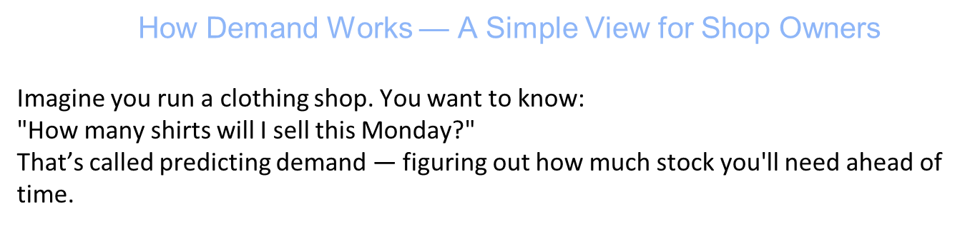
Demand Prediction

Slide 12
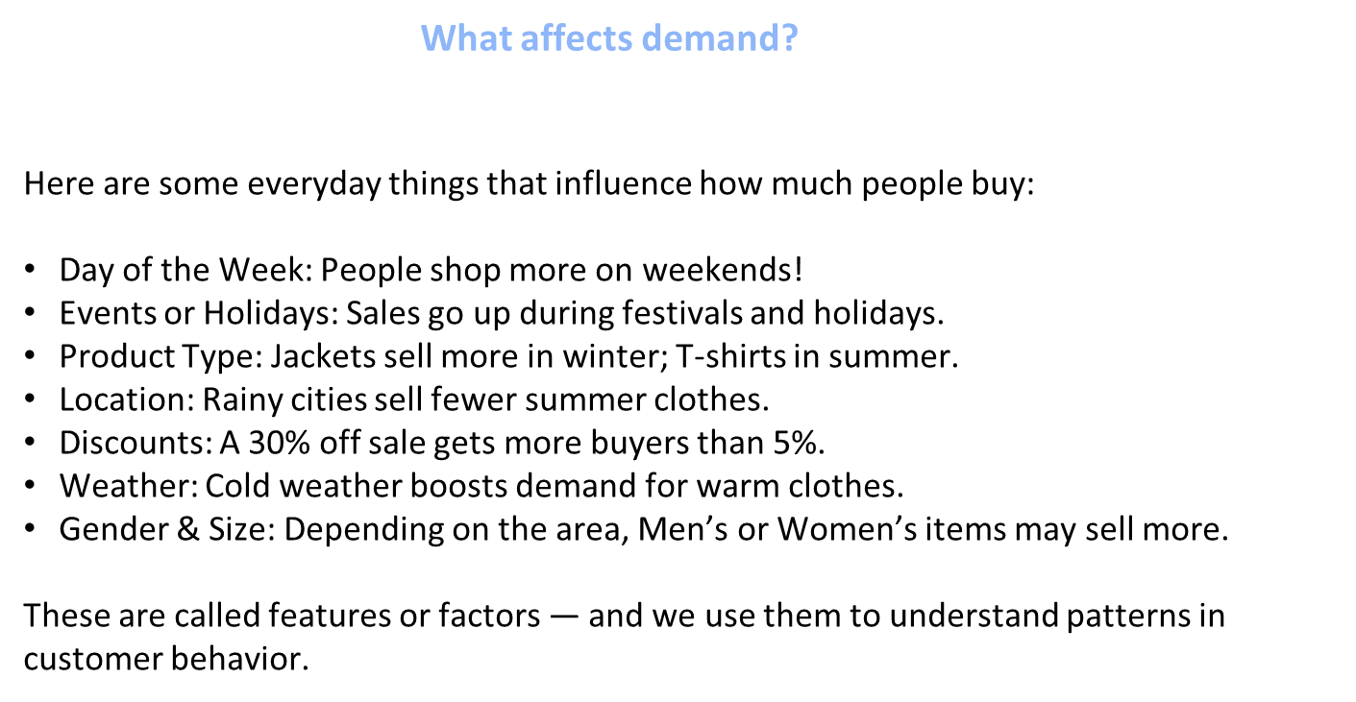
Demand Prediction

Slide 13
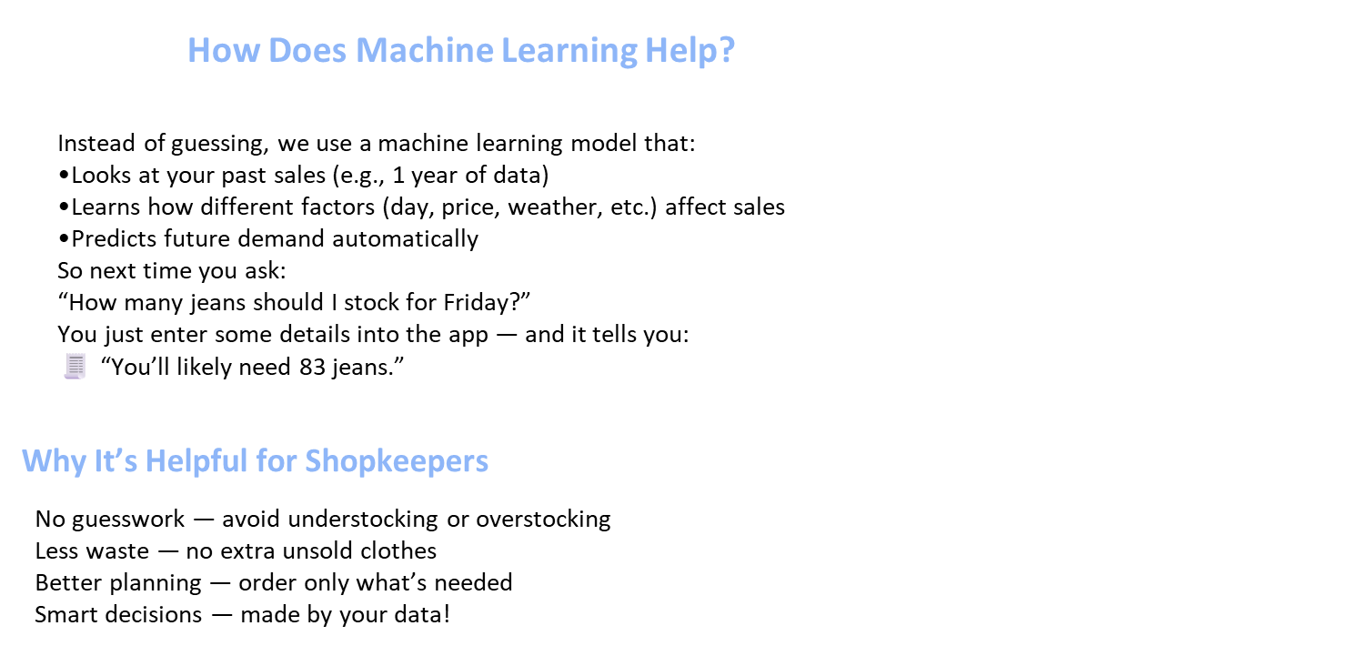
Demand Prediction

Slide 14

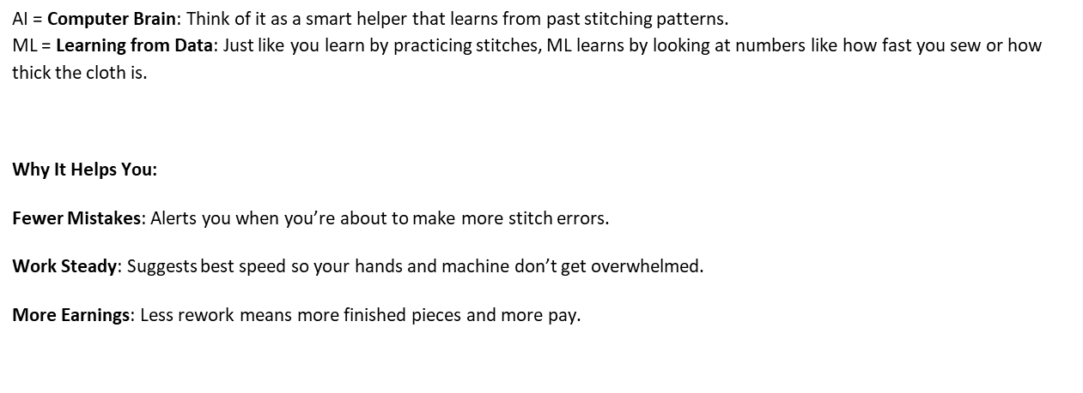
AI Worker Helper

Slide 15

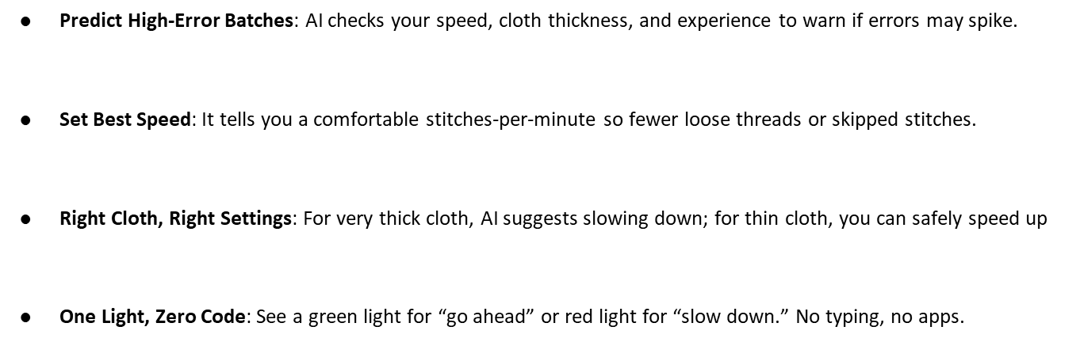
AI Worker Helper

Slide 16
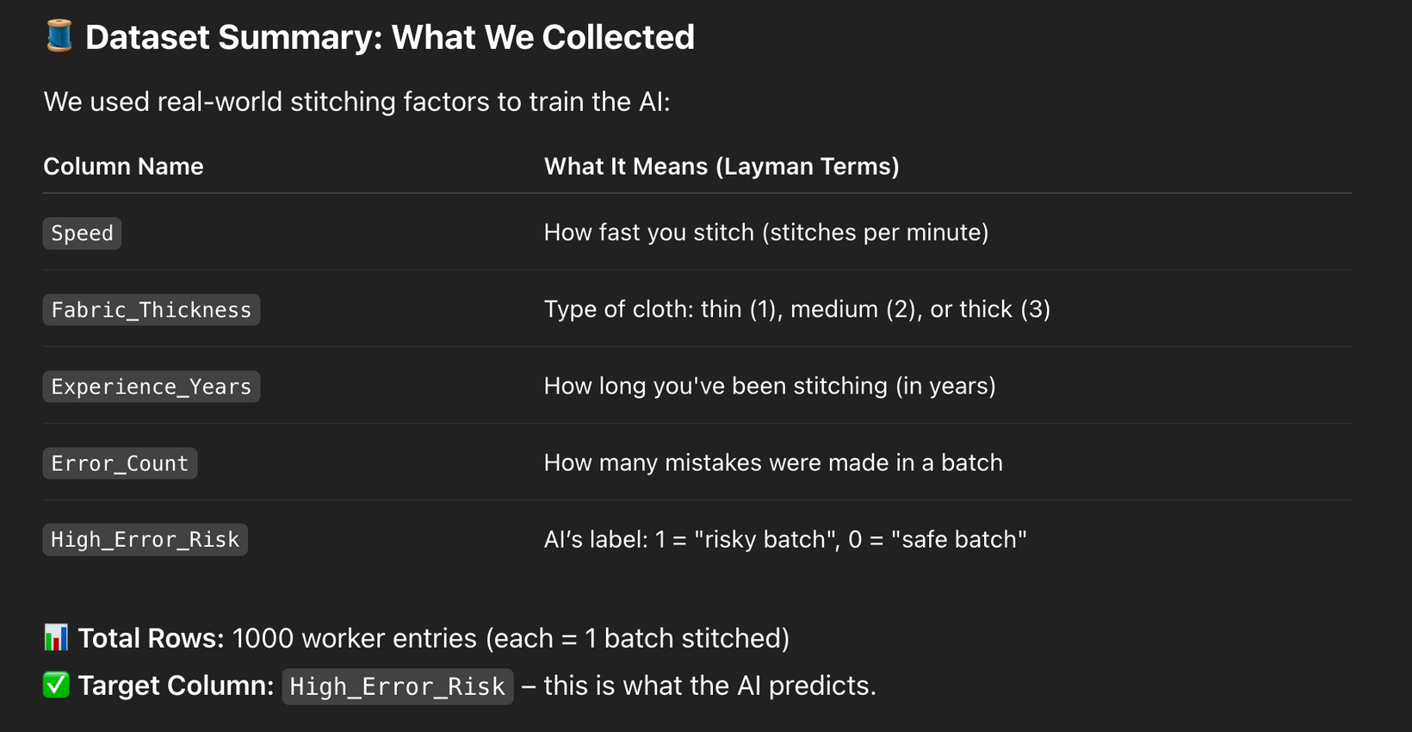
AI Worker Helper

Slide 17
ML approach
🤖 Machine Learning Architecture: How AI Thinks
We used a Decision Tree Model – like a flowchart AI uses to decide "risky" vs. "safe":
Input: Speed, cloth type, experience
Check:
Is stitching too fast for thick cloth?
Is the worker less experienced?
Output:
“Green light” (safe batch) or
“Red light” (high chance of errors)
🧠 Why Decision Tree?
Simple & fast – perfect for real-time alerts
Easy to explain to workers (like following yes/no steps)

Slide 18

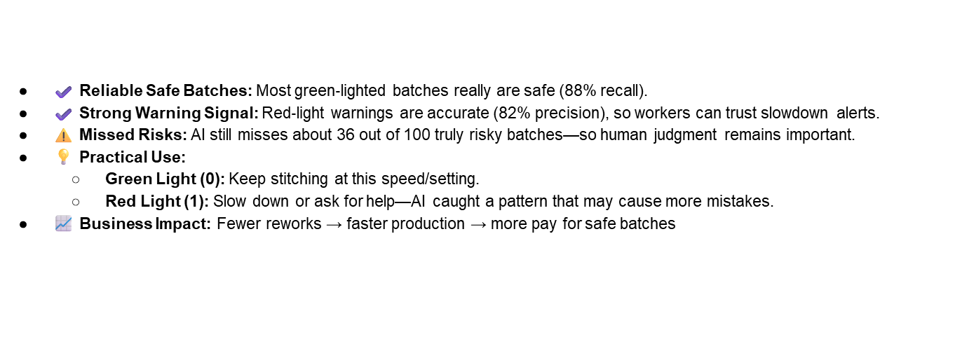
AI Worker Helper

Slide 19
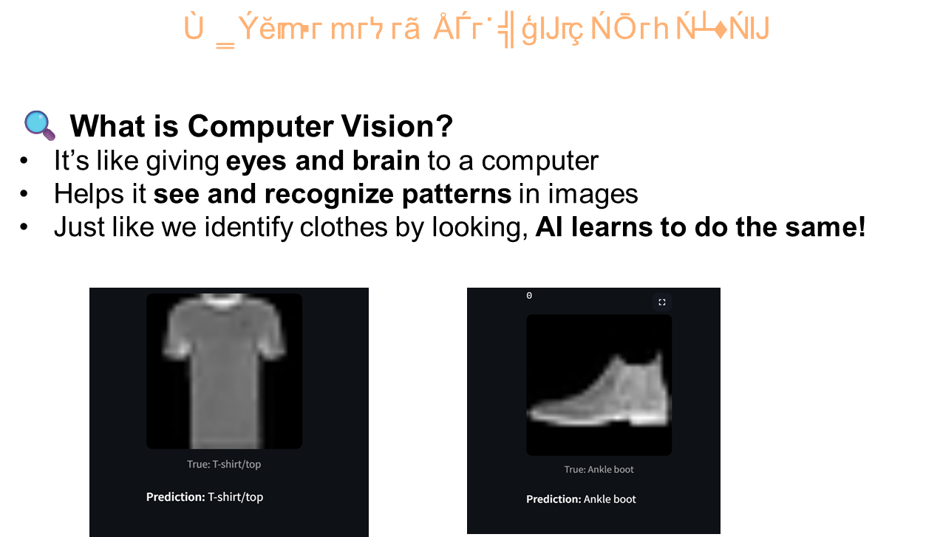
What is Computer Vision

Slide 20
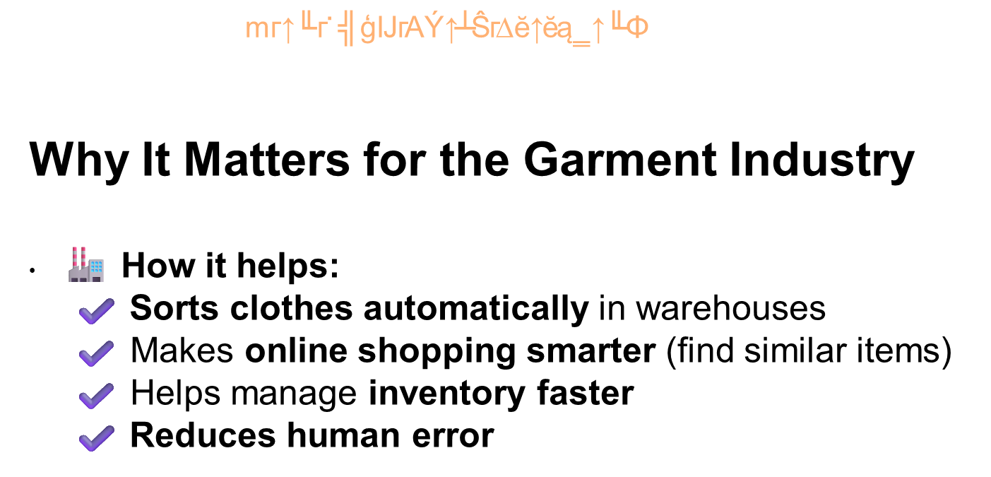
Why Computer Vision

Slide 21
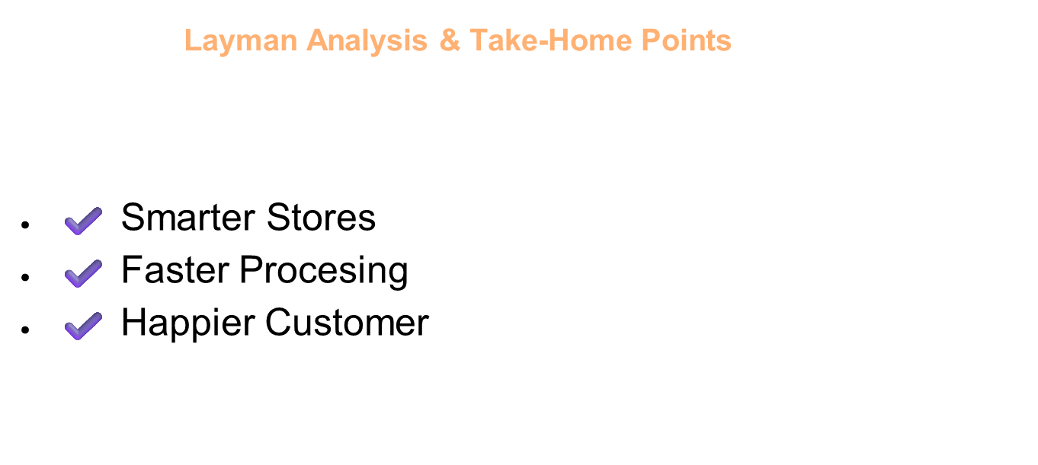
Why Computer Vision

Slide 22




Precision Fashion: HOG and KNN for Image Classification
Objective
HOG Features
Classify fashion images with high accuracy. We leverage Histogram of Oriented Gradients (HOG) for feature extraction. K-Nearest Neighbor (KNN) handles the classification. It performs well even on small datasets.
Extract rich descriptive features from images. This captures object shape and appearance. It focuses on gradient orientation and magnitude.
KNN Classification
Utilize K-Nearest Neighbors for robust classification. It finds the closest training examples. This determines the class of a new data point.

Slide 23
How AI Helps in Fashion Image Classification
Automates Product Tagging: AI models classify fashion items (e.g., "Dress", "T-shirt") from images, eliminating manual labeling.
Learns Visual Patterns: Through Histogram of Oriented Gradients (HOG) feature extraction and K-Nearest Neighbors (KNN) classification, the system learns how product types differ visually.
Improves Accuracy and Consistency: AI ensures uniform classification, even on thousands of images, reducing human errors.
Scalable to Larger Systems: This classical AI approach is a foundation for more complex deep learning models (e.g., CNNs), enabling smart search, recommendations, and trend analysis.

Slide 24






Training and Evaluating the KNN Model
Model Training
Train the KNN classifier. It uses the extracted HOG feature vectors. The model learns patterns from the training data.
Data Splitting
Divide the dataset into training and test sets. This ensures unbiased model evaluation. Typically 80% for training, 20% for testing.
Performance Evaluation
Achieve around 98% accuracy. Validate through confusion matrices. Classification reports provide detailed metrics. This ensures reliable performance assessment.

Slide 25
Why HOG-KNN is a Game Changer
98%
500
Accuracy
Small Data
High classification accuracy achieved. Validated across diverse fashion items.
Especially suitable for small image datasets. Avoids complex deep learning models.
1
100%
Interpretability
Extendability
Lightweight and easily interpretable solution. HOG features are visually intuitive.
Easily extendable to other datasets. Adaptable to various image classification tasks.

Slide 26
THANK YOU
Go, change the world

